Slide 1
RDF - Contenedores

Slide 2
Content
RDF W3C Overview
The basis of RDF
Internationalized Resource Identifier
Literals
Blank Nodes
More features of RDF
RDF Serialisations
Turtle
RDF Vocabularies
RDF on the Web
RDF subleties

Slide 3
Why IRIs (URIs)?
IRIs naturally have a “global" scope, unique throughout the web.
Contrasts to, e.g., keys in rel. DB which are unique within a table.
Helps to avoid name clashes.
Example: merging two product catalogues.
http://www.abc-company.com/category/item/123
http://www.xyz-company.com/product/123

Slide 4
Why triples?
Any information format can be transformed to triples.
Examples:
Tabular (spreadsheets, DBs): row column cell
Trees (XML): parent path child
Relationships are made explicit and elements in their own right.
The predicate, i.e., the relationship, is an element in the triple.
Unlike DB columns and binary predicates.
Can be described in RDF.

Slide 5
Why graphs?
A single, but highly versatile, format.
Everything is on the same format: triples!
Since RDF graphs are just sets of triples, basic set operations are well-defined.
Merging RDF graphs? Just take their union!
With tabular data, table dimensions must match.
With trees, a node can only have one parent.
Note that graphs need not be connected.
Extending an RDF graph? Just add more triples!
Need not redefine the database table, or to restructure the XML schema.

Slide 6
Content
RDF W3C Overview
The basis of RDF
Internationalized Resource Identifier
Literals
Blank Nodes
More features of RDF
RDF Serialisations
Turtle
RDF Vocabularies
RDF on the Web
RDF subleties

Slide 7
Some more features of RDF
Types of resources
Containers
Collections
Reification

Slide 8
RDF – types of resources
RDF has a special property for is-a relations: rdf:type
<http://www.polleres.net/foaf.rdf#me> rdf:type ex:Person.
<http://www.polleres.net/foaf.rdf#me> is-a ex:Person.
ex:Ucuenca rdf:type ex:Universidad .
ex:Ucuenca is-a ex:Universidad .

Slide 9
RDF Containers
RDF provides 3 types of Containers
rdf:Bag Unordered list of resources or literals.
might be used to describe a group of part numbers in which the order of entry does not matter
rdf:Sequence Sequence, ordered list of resources or literals.
might be used to describe a group that must be maintained in alphabetical order
rdf:Alt Alternative, list of resources or literals that are alternatives for the (single) value.
might be used to describe alternative language translations for the title of a book

Slide 10
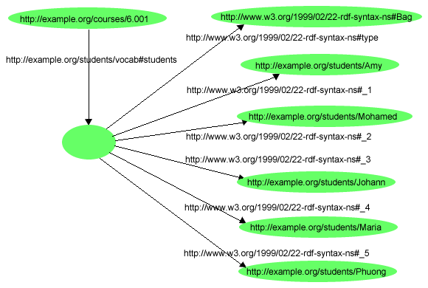
RDF Containers: example
Course 6.001 has the students Amy, Mohamed, Johann, Maria, and Phuong
What containers?
rdf:Bag

Slide 11
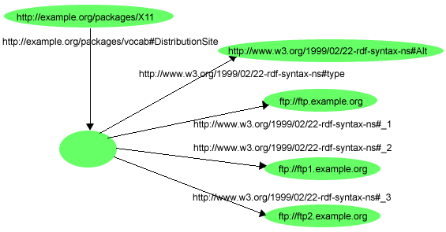
RDF Containers: example
The source code for X11 may be found at ftp.example.org, ftp1.example.org, or ftp2.example.org
What containers?
rdf:Alt

Slide 12
RDF Collection
Similar to RDF containers, but resolves collection as a list structure
This list structure is constructed using a predefined collection vocabulary
rdf:list
rdf:first
rdf:rest
rdf:nil

Slide 13
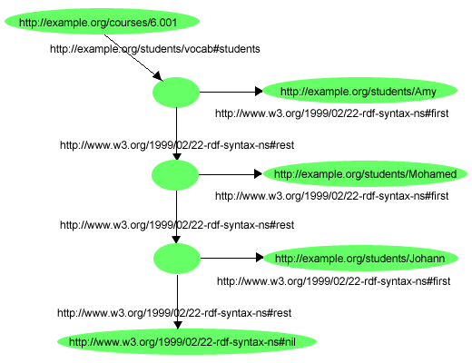
RDF Collection example
The students in course 6.001 are Amy, Mohamed, and Johann

Slide 14
Reification
Latin res ("Thing"), facere ("make")
– an Explication
• In rdf statement about statements
"Peter says that Rome is the capital of Spain.“
Implementation:
– RDF Statements are considered resources themselves
– Can be subject or object of other statements
• Reification can have multiple levels
– “Peter says that Wikipedia states that Rome is the capital of Spain.”

Slide 15
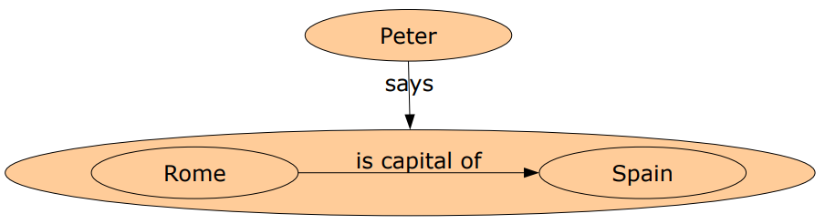
Reification in RDF
"Peter says that Rome is the capital of Spain.“

Slide 16
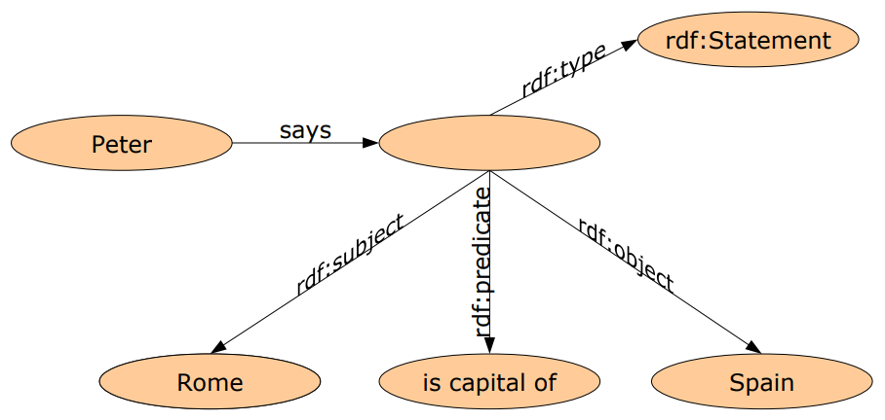
Implementing Reification as Standard RDF

Slide 17
Práctica 8

